Slide 1

Alcohol and Crime in the Australian Capital Territory¶
February
2020

Slide 2
Background

Slide 3
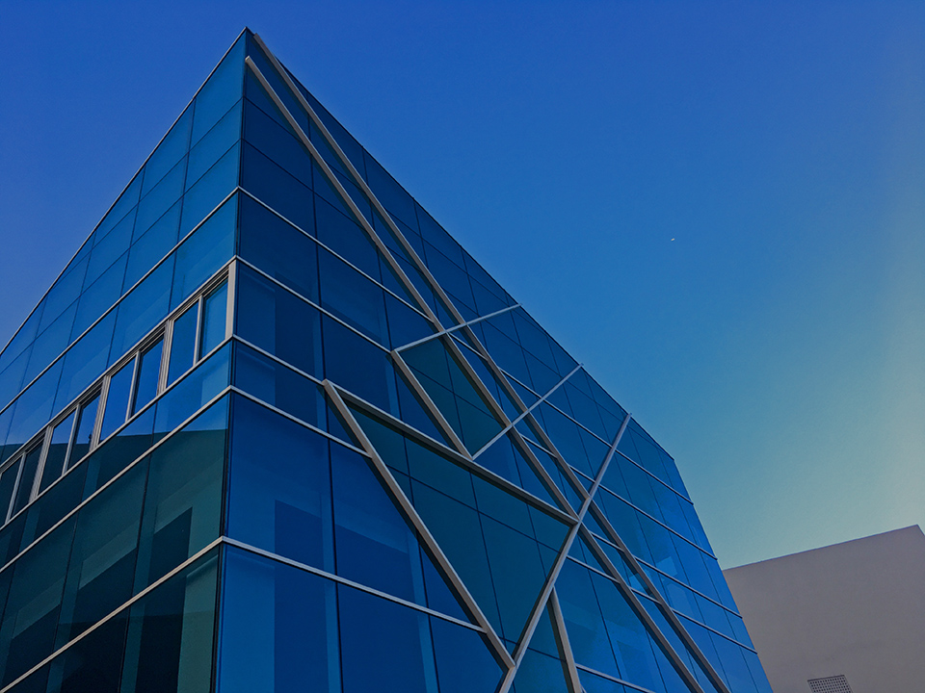
Background
Australia, alcohol and violence
Recently, in Australia, there has been strong debate about alcohol and violent crime, due to cases of alcohol-fuelled assaults.
Australia’s state of New South Wales introduced laws restricting trading hours for venues that supply alcohol to consumers.
The Australian Capital Territory has no New South Wales-style alcohol control laws.

Slide 4
Background
Purpose of Study
This study aims to examine the connection between alcohol-related venues and violent crime in the Australian Capital Territory.
This will be useful to provide a data-informed framework for decisions on alcohol control by the Australian Capital Territory Government.
Users of the study could include the Australian Capital Territory Government and ACT Policing.

Slide 5
Methodology

Slide 6
Methodology
The study used OPTICS clustering on crime rates in the Australian Capital Territory and alcohol-related venue data from Foursquare.
OPTICS clustering looks for clusters by looking for nearby data points with similar characteristics. Unlike some other clustering techniques, it can deal with data of variable density and has a concept of outliers.
An algorithm was then used to check if suburbs that were in the same cluster for one dataset (such as the crime dataset) were also in the same cluster in the other dataset (such as the alcohol-related venue dataset from Foursquare).

Slide 7
Results

Slide 8
Results
Alcohol-related venue clusters
There were two clusters.
Cluster 0 contains Amaroo, Bonner, Conder, Dickson, Hawker, Oaks Estate and Pearce. Cluster 0 has the lowest number of alcohol-related venues in the Foursquare data.
Cluster 1 has the neighbourhoods of Chisholm, Duntroon, Hughes, Macquarie, Melba and Reid. Cluster 1 has the highest number of venues.

Slide 9
Results
Crime clusters
There were four clusters.
Cluster 0 includes City, Garran, Hume, Molonglo and Phillip. Cluster 0 has the highest rates of all types of violent crime and the highest rate overall.
Cluster 1 has Belconnen, Bruce, Nicholls, Waramanga, Weston and Yarralumla. Cluster 1 has the second highest rates of all types of violent crime, except family violence which is second lowest. Cluster 1 also has the second highest rate overall.
Cluster 2's neighbourhoods are ACT South West, Bonython, Casey, Giralang, Isabella Plains, Macgregor. Cluster 2 has the lowest rates of all violent crime, except family violence which is second highest and other offences against a person which is second lowest. Cluster 2 also has the lowest rate overall.
Cluster 3 has Acton, Kaleen, Red Hill, Turner and Watson. Cluster 3 has the second lowest rates of all violent crime, except family violence and other offences against a person that were lowest. Cluster 3 also has the second lowest rate overall.

Slide 10
Results
Overlap of clusters
No clusters overlapped.
There were, however, many outliers that did not fall into clusters in the results.
This means there is a need for further analysis before concluding no association between alcohol-related venues and violent crime.

Slide 11
Discussion

Slide 12
Discussion
The analysis suggests there is no association between the availability of alcohol-related venues and patterns of violent crime, for clustering from an OPTICS clustering analysis.
There were many outliers within the analysis; however, and so there is a need for subsequent research to validate the results.
The discovery of clusters for patterns of violent crime also merits further research to determine the drivers of the patterns.
Overall, more research is needed to examine whether alcohol drives violent crime in the Australian Capital Territory.

Slide 13

THANK YOU!

